Slide 1
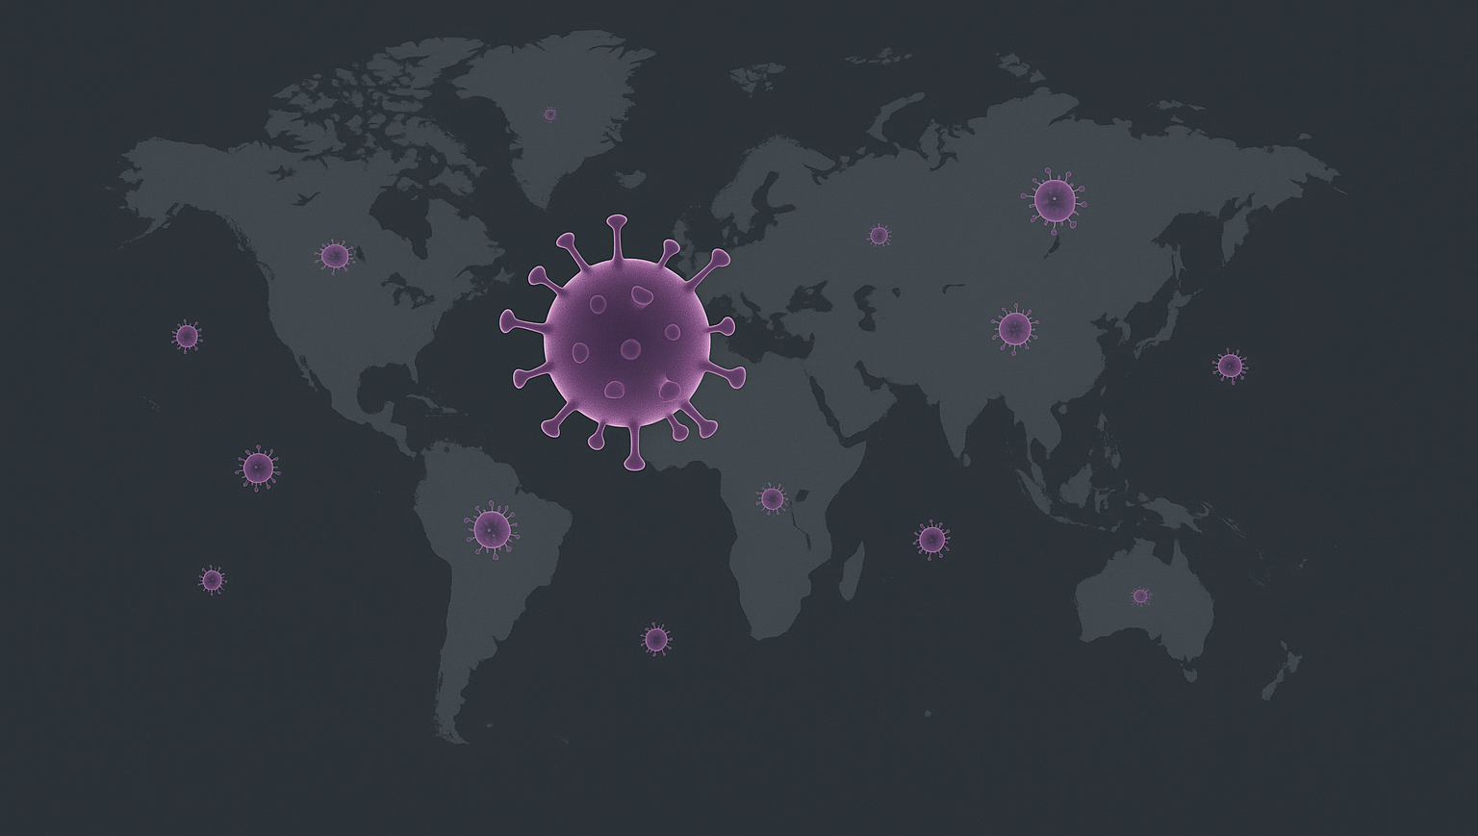
COVID-19 GLOBAL TRACKER

Slide 2
INTRODUCTION
The COVID-19 pandemic has profoundly affected global health, economies, and daily life since its emergence in late 2019. Caused by the SARS-CoV-2 virus, the disease has led to millions of infections and significant loss of life worldwide. In response, countries implemented a range of public health measures, with varying levels of success.
This presentation offers a comprehensive analysis of COVID-19 data, including confirmed cases, deaths, and recoveries. By exploring trends across different countries and regions, we aim to highlight the scale of the pandemic, identify critical hotspots, and evaluate the outcomes of interventions over time. The insights drawn from this data can support ongoing efforts in preparedness, response, and future policy planning.

Slide 3

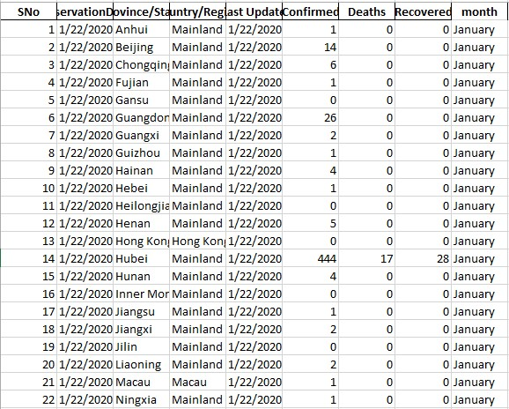
DATASET

Slide 4
KEY INSIGHTS
High Mortality in Certain Countries: Countries like Brazil, Belgium, and Canada show significantly high cumulative death counts, indicating severe national-level impact or reporting completeness.
China's Early Case Concentration: Initial COVID-19 cases were concentrated in Mainland China, with provinces like Beijing, Chongqing, and Anhui reporting early confirmed cases in January 2020.
Disparities in Case Outcomes: The ratio of confirmed to recovered cases varies, suggesting differences in healthcare capacity, testing, or the timing of outbreaks.
Temporal Patterns: Case and death data show distinct monthly trends—initial surges in early 2020, with rising or declining trends varying by country and region.
Data Gaps and Reporting Challenges: Some sheets show missing or unstructured data, highlighting challenges in real-time global data collection and standardization.

Slide 5

CHARTS USED
Bar Chart – Confirmed Case by State
Area Chart – Death by Country
Line Chart – Observation Date by Recovered
Pie Chart – Top 10 State Wise Recovery

Slide 6
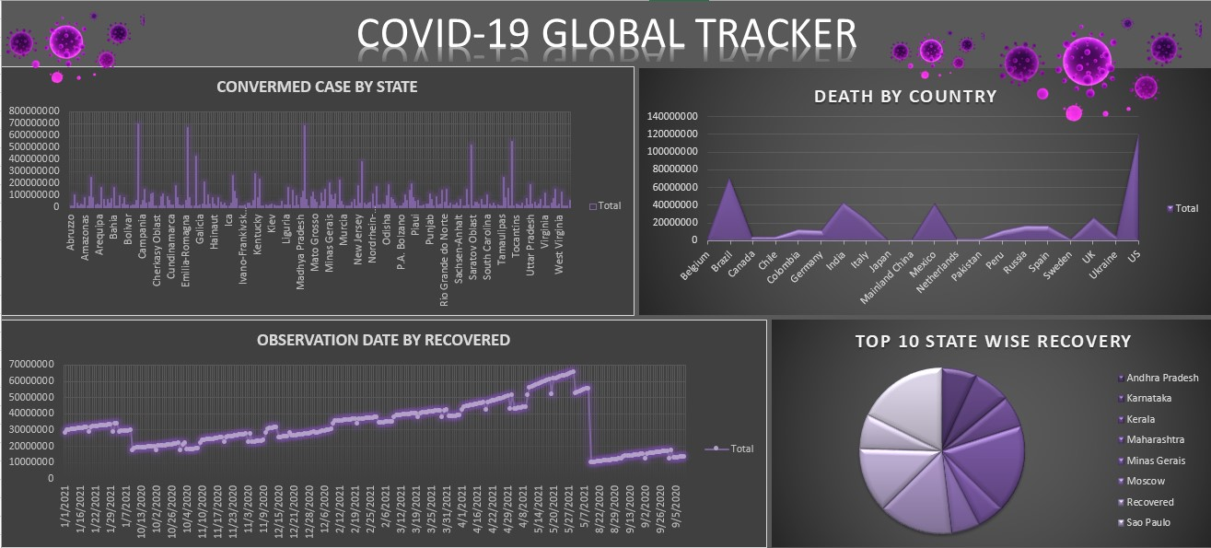
DASHBOARD

Slide 7
CONCLUSION
The analysis of COVID-19 data highlights the vast and uneven impact of the pandemic across countries and regions. While some areas were able to respond quickly and effectively, others experienced high case and death tolls due to various factors such as healthcare capacity, timing of outbreaks, and public health policies.
Key trends show that early intervention, consistent testing, and healthcare readiness played crucial roles in managing the crisis. However, global disparities in data reporting and healthcare access remain major challenges.
As we reflect on this data, it reinforces the importance of preparedness, real-time surveillance, and international collaboration in facing future public health emergencies.

Slide 8

REFERENCES
KAGGLE

Slide 9
Thank you

